Slide 1
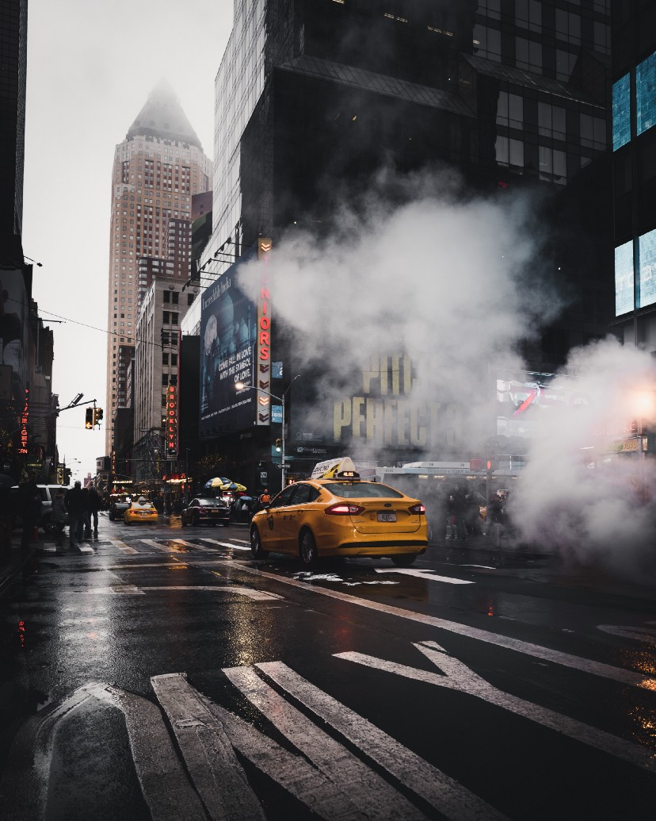
Making New York City Roads Safer
A presentation to the New York City Council
by Trish Kanhuru

Slide 2

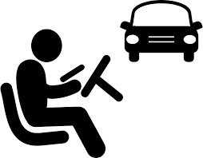



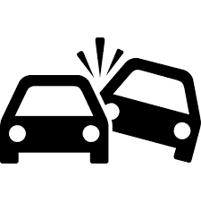
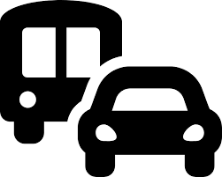
Summary
From 2012 – 2022 New York City had 1 939,982 collisions Here are some key insights:
5363 Deaths
1 131,609 Injuries
515 avg. collisions
per day
Top 3 contributing factors:
Distracted Driver
Failure to yield right of way
Backing unsafely

Slide 3
Analysis Approach
The problem
Have a good understanding of the problem statement: How to reduce accidents in New York based on the 2012 -2020 data.
Prep the data
Got clarity of the data and performed data cleaning(duplicates and null values etc)
Deep Dive
Prepped data and analysed top collision causes, carried out time analysis, most prone areas and fatality analysis.
Recommendations
Provided recommendations based on insights obtained.
Insights
Results were presented in a Dashboard using PowerBi to allow stakeholders to interact with the data to get more insights

Slide 4
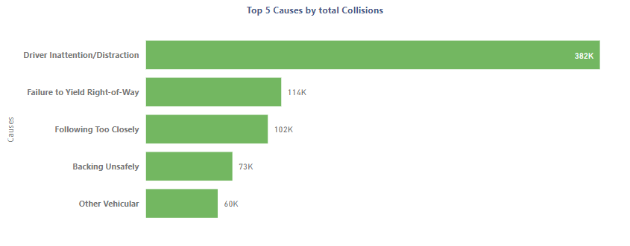
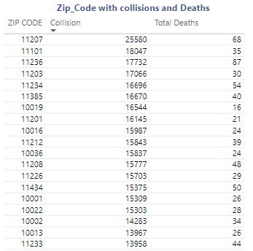
Collisions and prone areas
The top 5 causes were driver errors with driver Inattention leading to 20 % of collisions
85 % of the collisions were caused by unspecified reasons.
ZIP Codes with the most frequent collisions are 11207 and 11101 (one in Brooklyn, the other in Queens). Zip code 11236 was the zip code with more deaths.

Slide 5
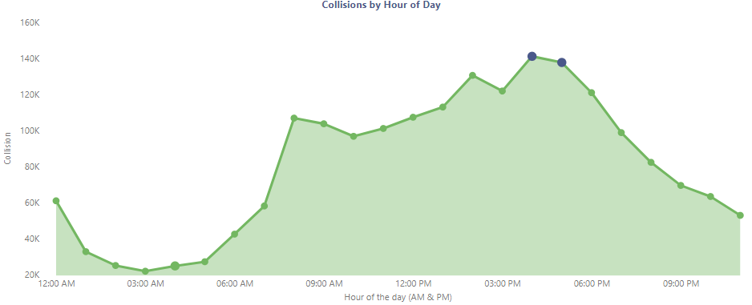
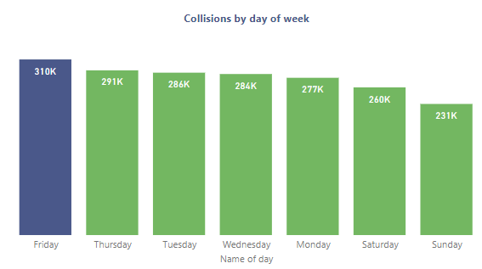
Time Analysis
Most accidents occurred at 4PM and 5PM (rush hour)
Friday had the most collisions(309771).

Slide 6
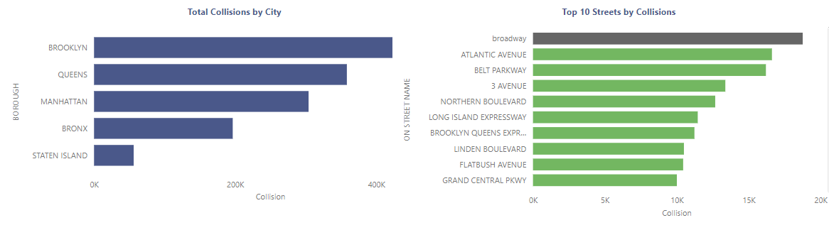
City and street analysis
Most collisions and most people are being killed in Brooklyn, and, all other boroughs follow the pattern of the “death distribution” between the different traffic participants.
We can see that Broadway (Manhattan) and Atlantic Avenue are the most critical spots in New York City.

Slide 7
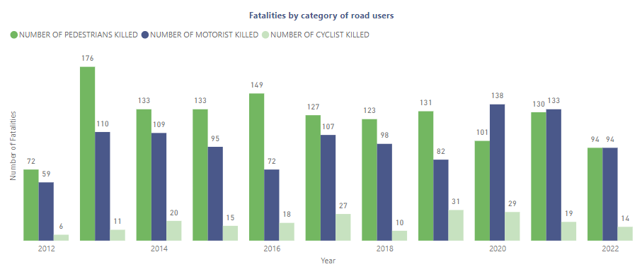
Fatality analysis
This revealed that pedestrians were killed more often than other road users whenever collisions occurred. (Note excluding persons in the vehicle)

Slide 8
Recommendations
Increased frequency of driver re-training and more stringent fines for repeat offenders.
Increased road usage sensitization for pedestrians especially and other road users.
Focus on high collision-prone areas and streets in terms of prioritizing new projects like traffic lights or street signs.
Deploy more traffic wardens on days with higher collision rates and on black spots areas.

